Slide 1
TDD Hands-On <1>
Wei Xiao
June 5, 2015

Slide 2
TDD Cycle
Test fails
Test pass
Refactor

Slide 3
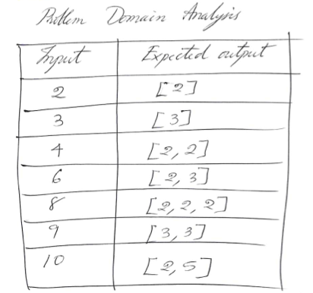
Exercise
Factorize a positive integer number into its prime factors.
找出一个正整数的所有质因数

Slide 4
DEMO
https://vimeo.com/97516288
Start from 32’50

Slide 5
TDD
Starts with confidence
Deals with specific cases then
Concludes generic cases

Slide 6
TDD is design tool or testing tool ??

Slide 7
What scenarios can TDD be used in?
What *Not*?
If *Not*, what do we do?

